Slide 1


ESPERTO Watch
University of waterloo engineering society sponsorship
Fall 2017

Slide 2

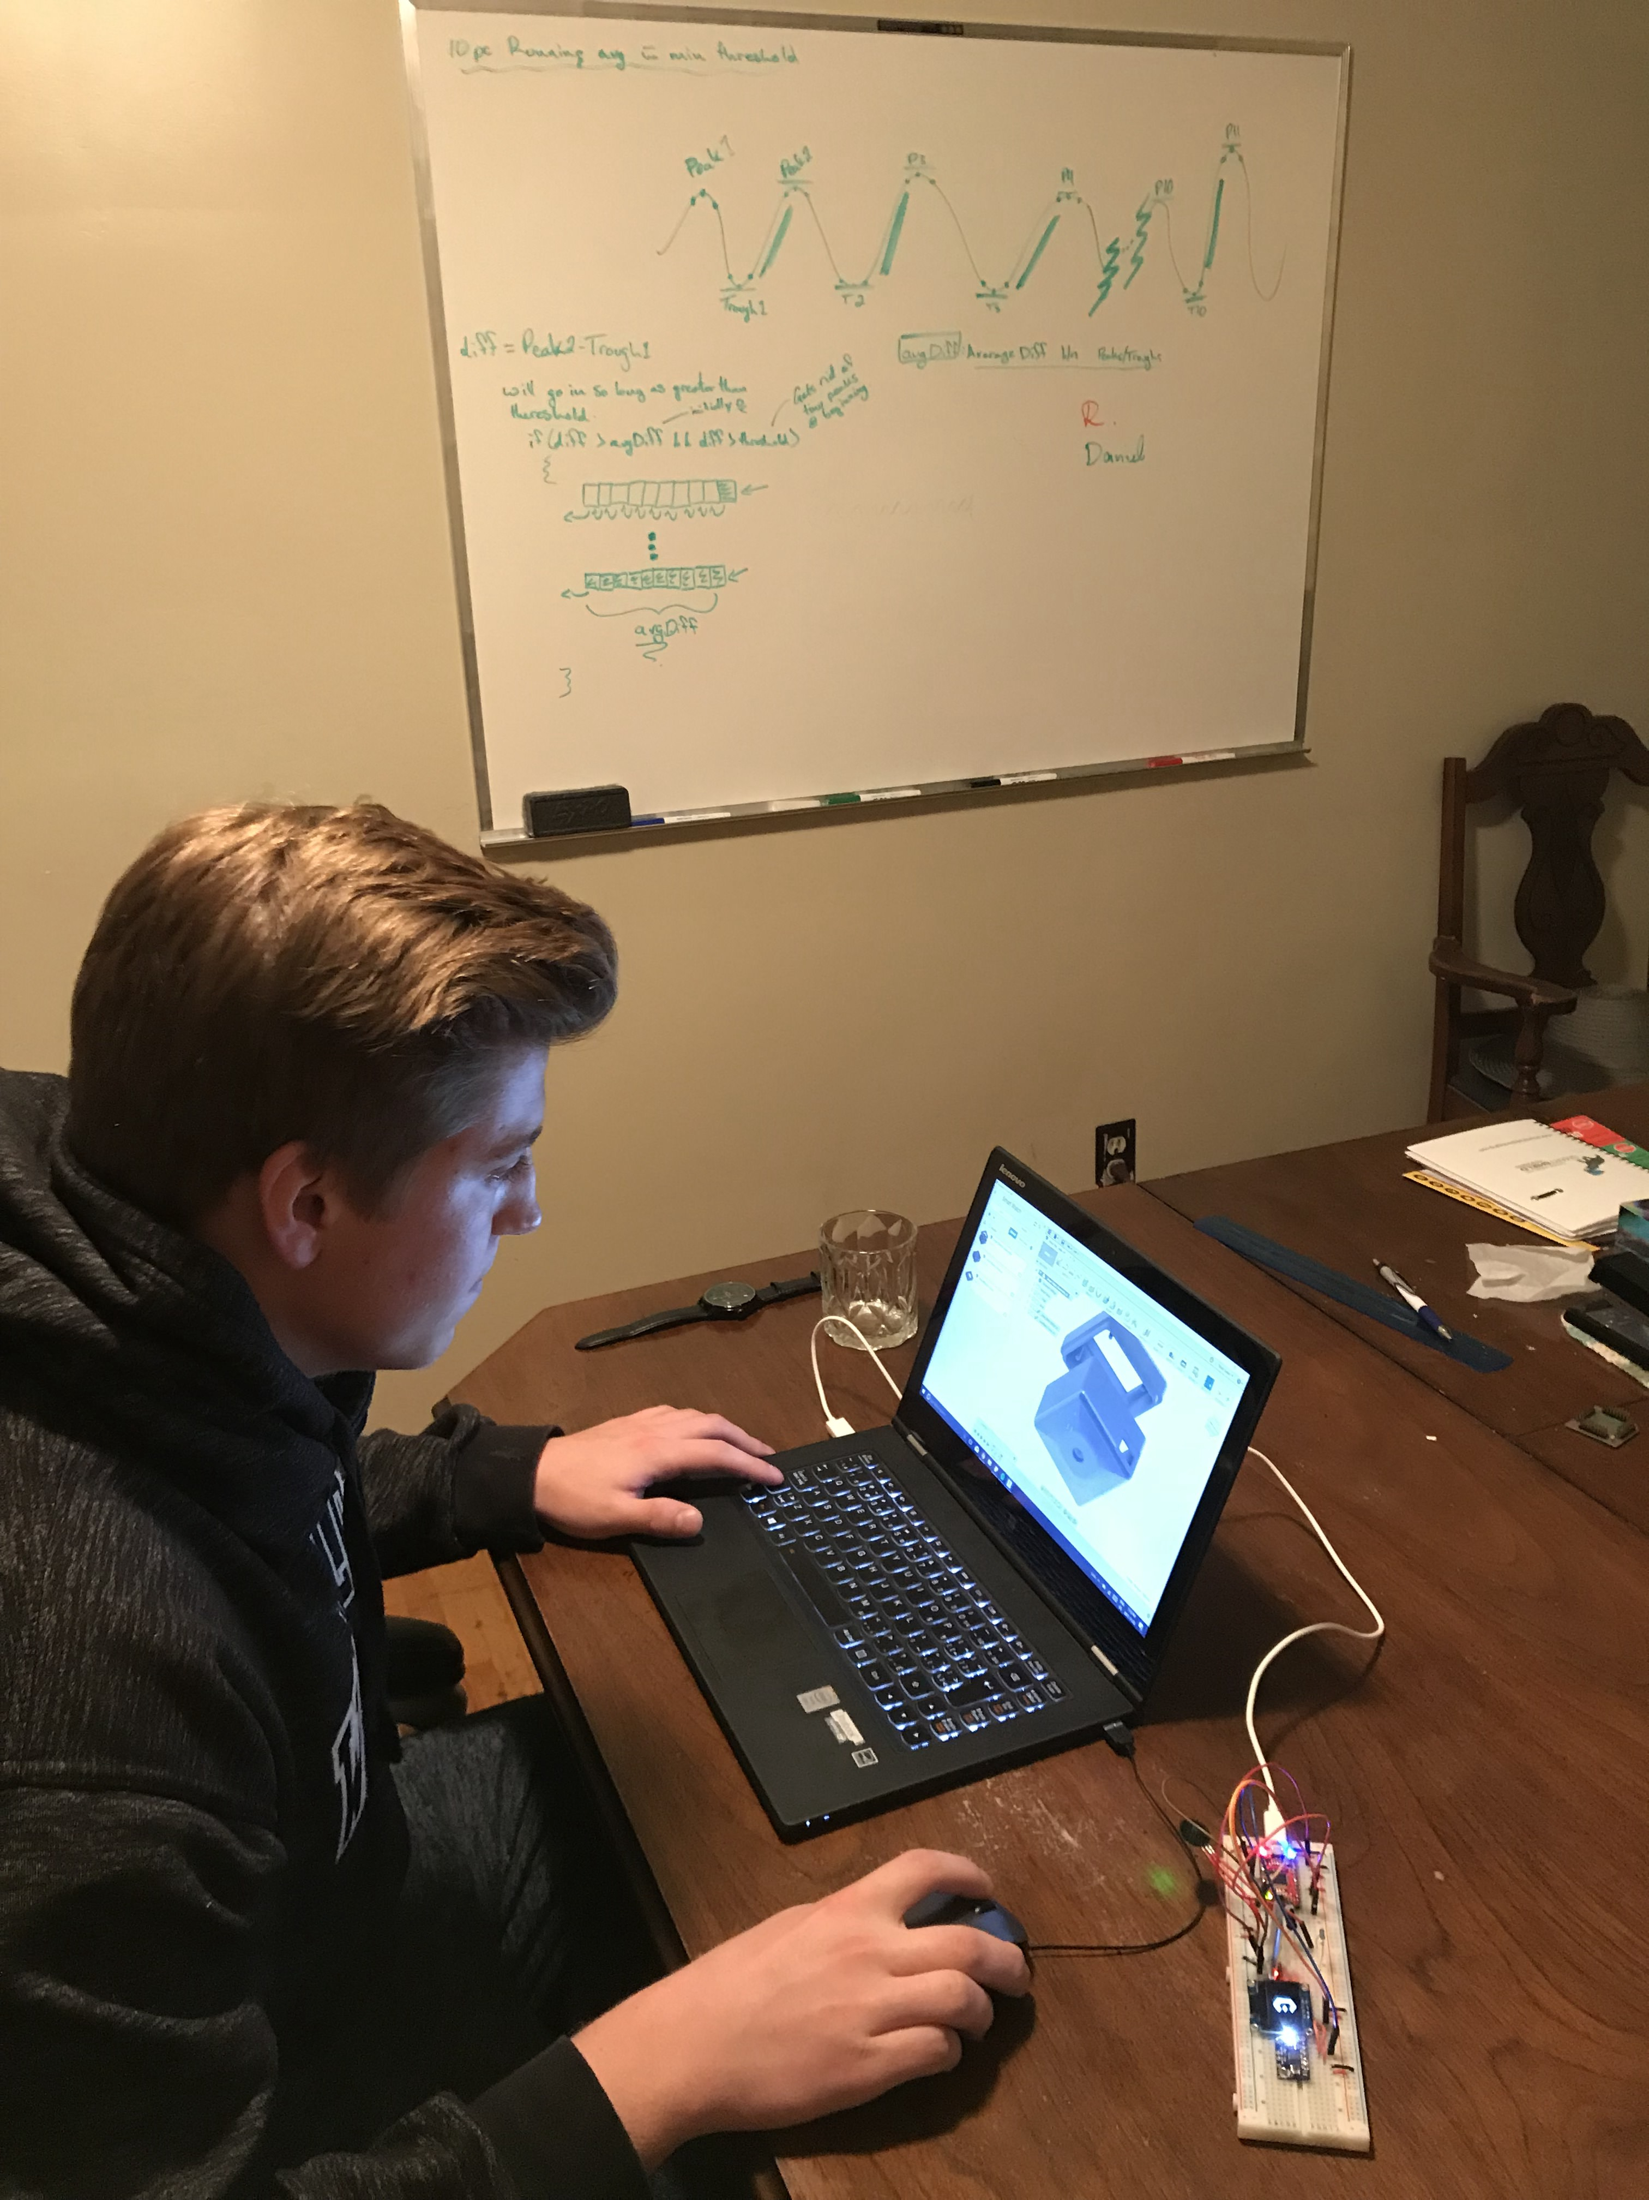
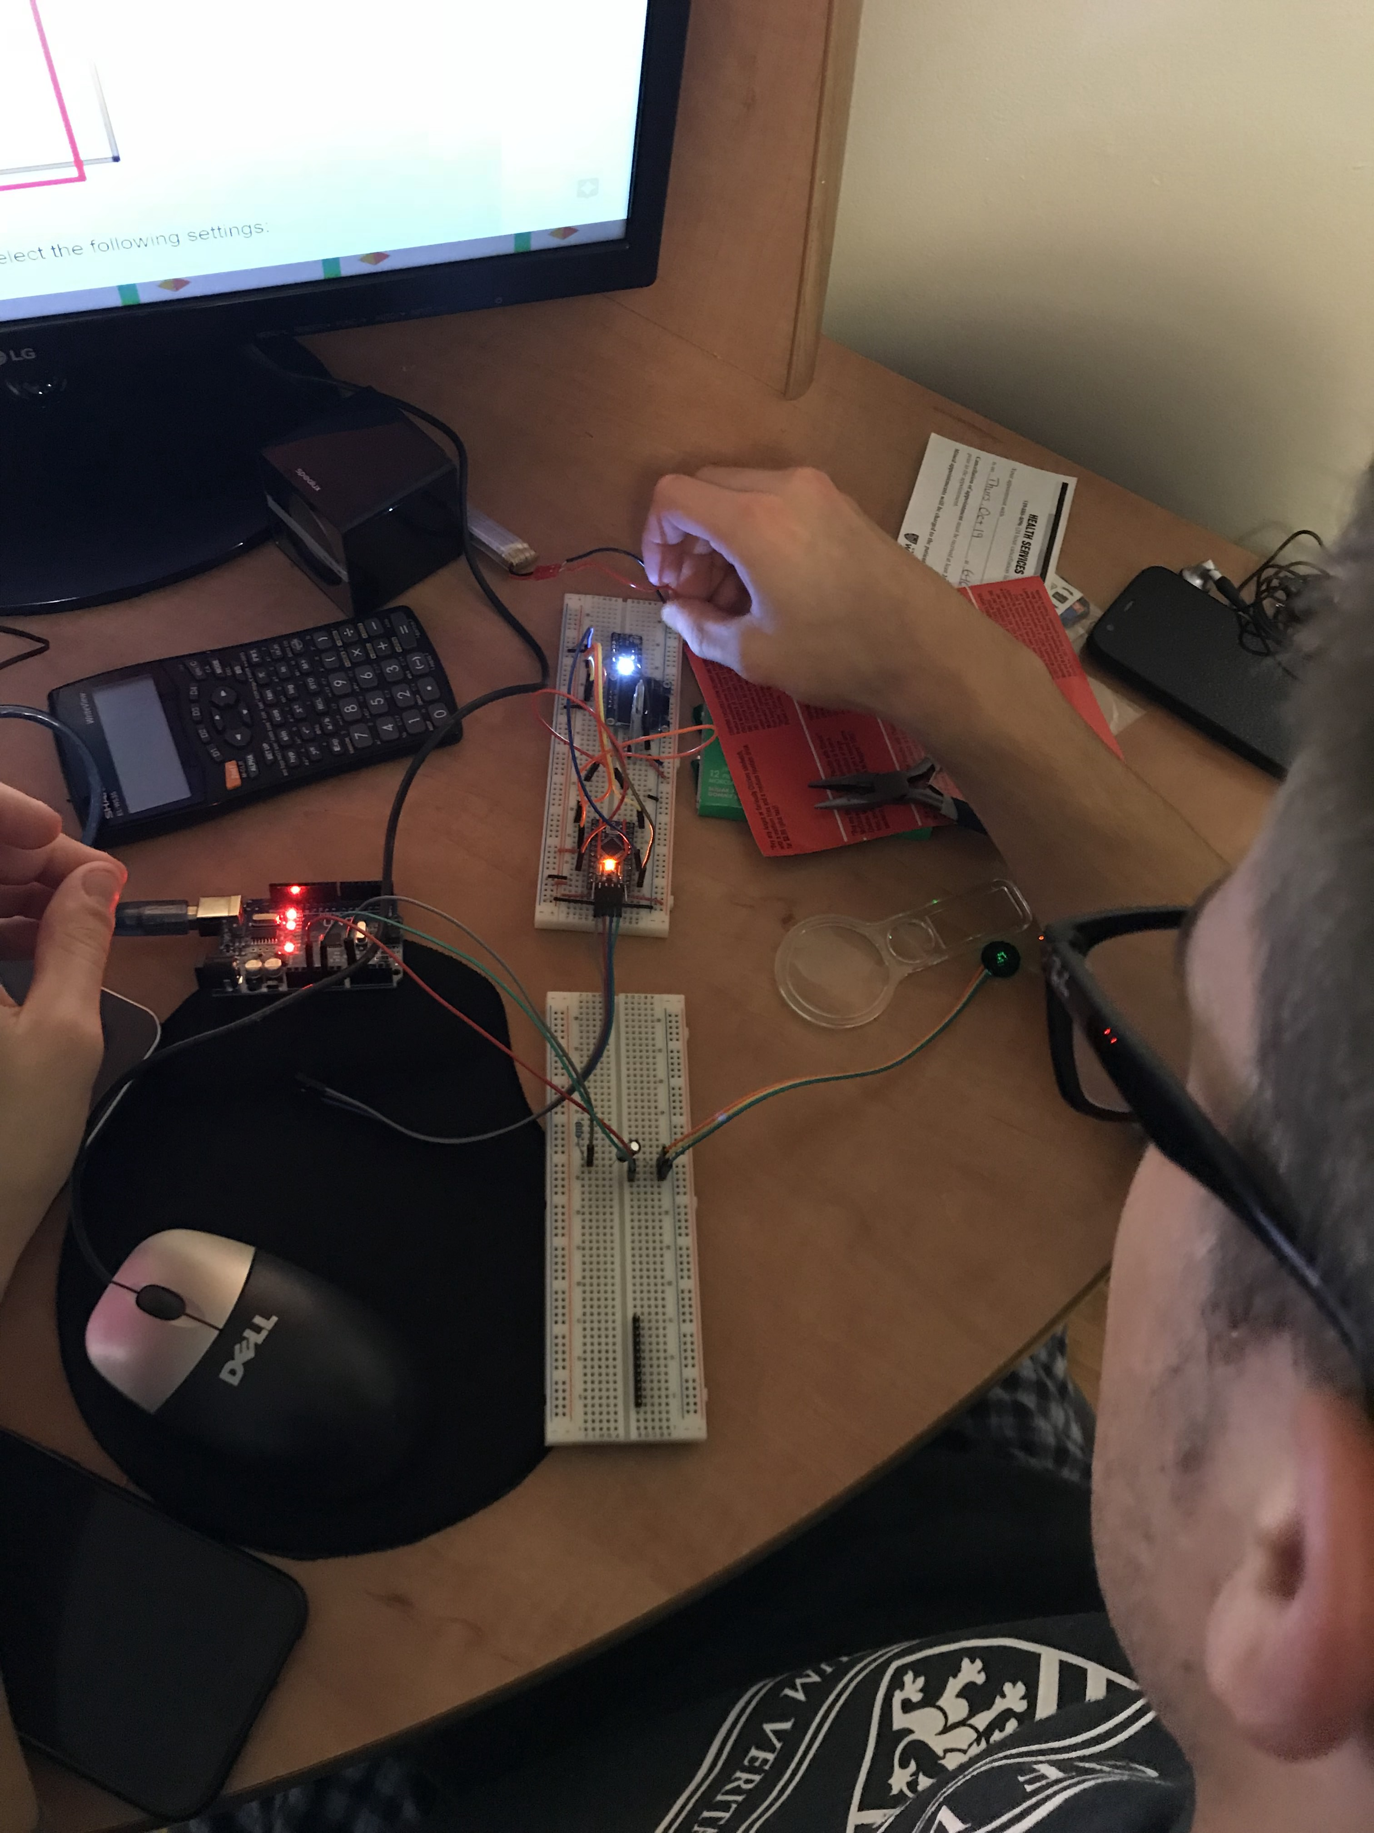
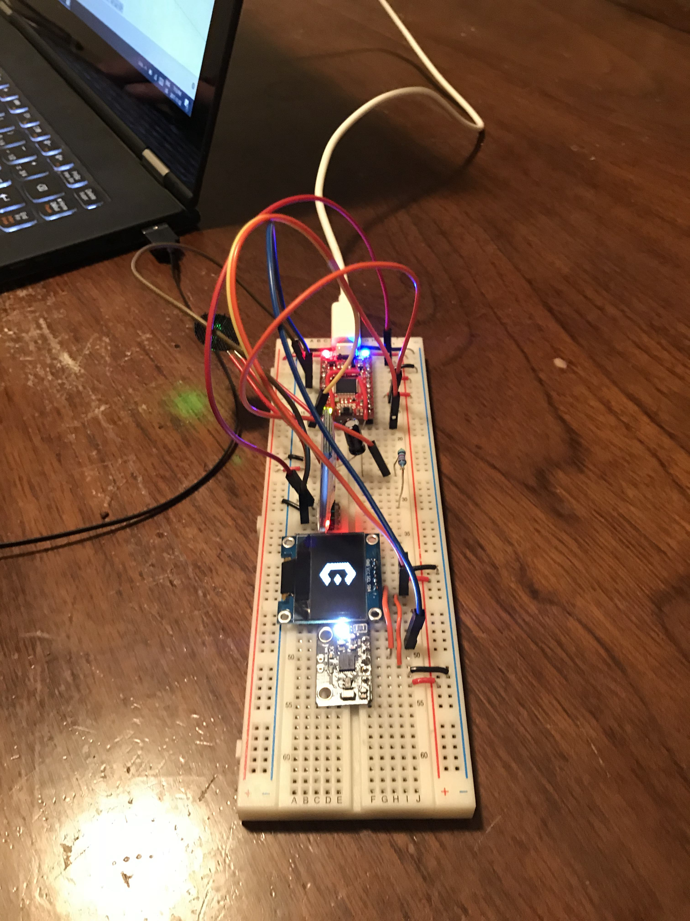
The beginning of esperto
At first, there were two . . .

Slide 3
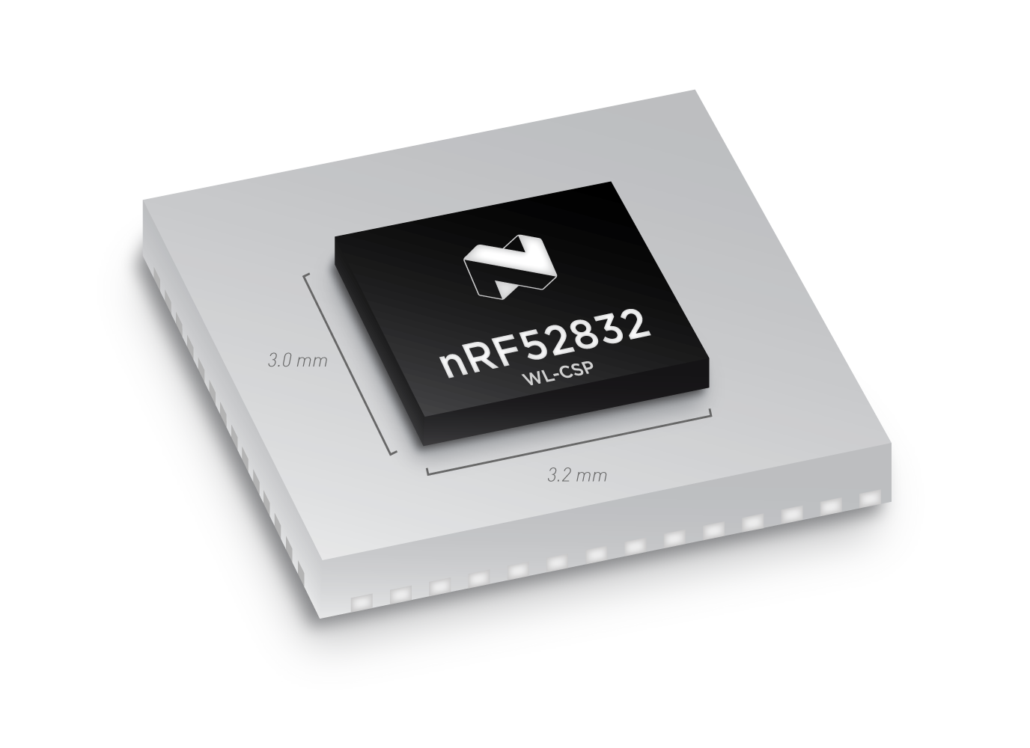
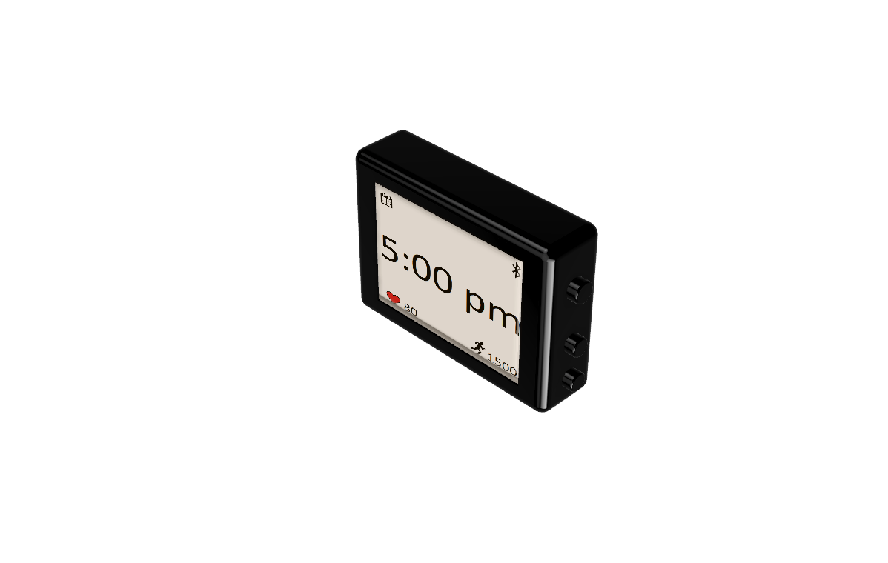
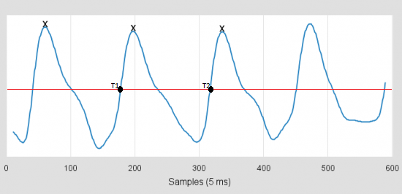
Current work
Hardware Implementation
Mechanical Design
Algorithm Development

Slide 4
statistics
Over 300 student hours have gone into developing, researching, and testing the Esperto smartwatch
More than 700 lines of development and test software written
3 prototypes built and 1 in the making
Students from 4 different programs with plans to begin working with students from other faculties and programs once funding is confirmed

Slide 5
Thank you for listening!
From the Esperto Team

